Slide 1
On the Gain of Joint Decoding
for Multi-Connectivity
Albrecht Wolf, Philipp Schulz, David O¨ hmann, Meik Do¨rpinghaus, and Gerhard Fettweis
Vodafone Chair Mobile Communications Systems, Technische Universit¨at Dresden, Germany
GLOBECOM 2017 - 2017 IEEE Global Communications Conference
Notes:
Multi-Connectivity被認為是實現未來無線網絡中可靠傳輸的關鍵。 傳輸可靠性取決於所使用的合併算法，例如Joint decoding（JD），maximum selection combining（MSC）和maximum ratio combining（MRC）。
這篇為了比較這三種組合演算法的性能，作者基於Distributed Source Coding 也就是”分布式信源編碼”，來得出他們在Multi-Connectivity時的中斷概率(outage probability)。

Slide 2
Agenda
1
MULTI – CONNECTIVITY
2
SYSTEM MODEL
3
PRELIMINARIES & OUTAGE PROBABILITY
4
NUMERICAL RESULTS

Slide 3
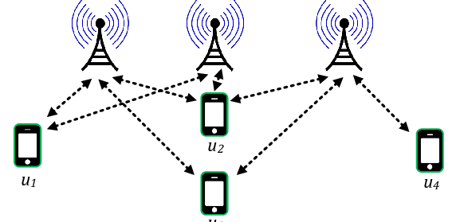
Multi – connectivity (MC)
Multi-Connectivity:
In wireless communications, MC concepts have been mainly developed and applied for increasing data rates and capacity. Various ways exist to realize MC and we distinguish between two types, namely, intra- and inter-frequency MC.
Established principles realizing intra-frequency MC are single frequency networks and coordinated multi-point.
Notes:
在超可靠的低延遲傳輸（URLLC）的背景下，5G將面臨一些挑戰以應對新興的應用場景。 這些要求對物理層是巨大的挑戰。 在第四代移動網絡（4G）中，可靠性是通過混合自動重發請求過程獲得的，該過程會重發錯誤接收的封包。 但是，URLLC的嚴格時間限制不支持多次重傳。因此Multi – connectivity被視為在5G中對於URLLC有前途的概念，Multi – connectivity 有兩種一種是Intra-MC，Intra-MC的實現原理是單頻網路和多點。相對的另一種inter-MC就是base stations在不同的載波頻率中同時向單個user傳送訊號。在無線通訊中，MC的概念應用在增加data rate 及capacity 因為他可以用不同link傳送不同的訊息，但其實multiple connection也可以用在強化可靠度上，就變成在不同的link傳送同一個資料。

Slide 4
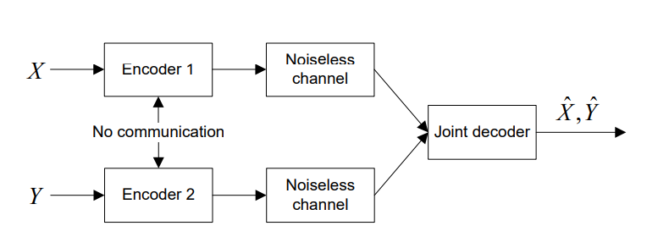
Distributed Source Coding
Distributed source coding (DSC) is an important problem in information theory and communication. DSC problems regard the compression of multiple correlated information sources that do not communicate with each other. By modeling the correlation between multiple sources at the decoder side together with channel codes, DSC is able to shift the computational complexity from encoder side to decoder side, therefore provide appropriate frameworks for applications with complexity-constrained sender. One of the main properties of distributed source coding is that the computational burden in encoders is shifted to the joint decoder.
Notes:
Distributed source coding(分布式信源編碼)基於訊息熵(entropy)值提出兩相關訊號源的無失真壓縮理論[12]。是對信息互相關聯但不互相通信的信源的一種信息壓縮方式。重要的是，即使在獨立編碼的情況下，仍然可以透過合併解碼的方式得到相同的理論熵值。
Distributed source coding能夠將計算複雜度從編碼器端轉移到解碼器端，他的主要特性之一是將編碼器中的計算負擔轉移給聯合解碼器。

Slide 5
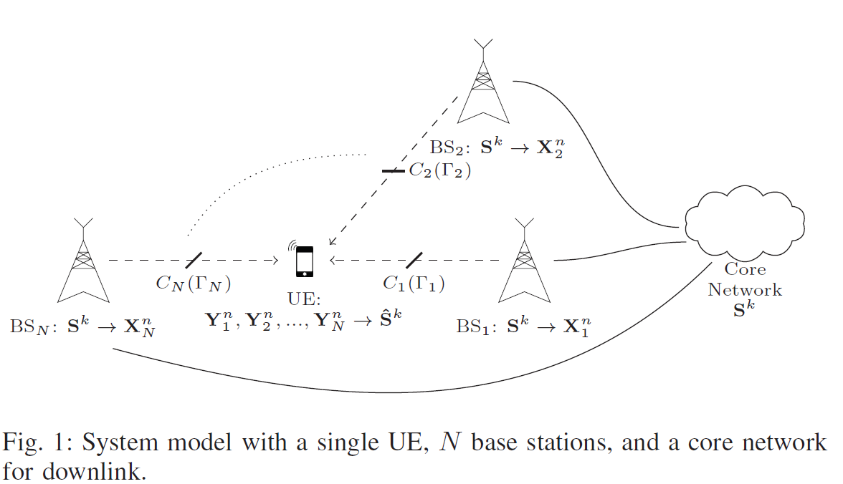
System Model
Insert the title of your subtitle Here
Notes:
這是一個 Multi-Connectivity cellular network， 包含了一個core network , N個base stations ，他們都與一個user 做溝通。core network協調與UE的數據傳輸。Core network 與各個base stations 以backhaul links形式連接，Base stations與UE是以無線網路連接。 那每一個wireless link可達到的transmission rate取決於他的capacity C i( Γ i )，也就可以等同於它的SNR。

Slide 6

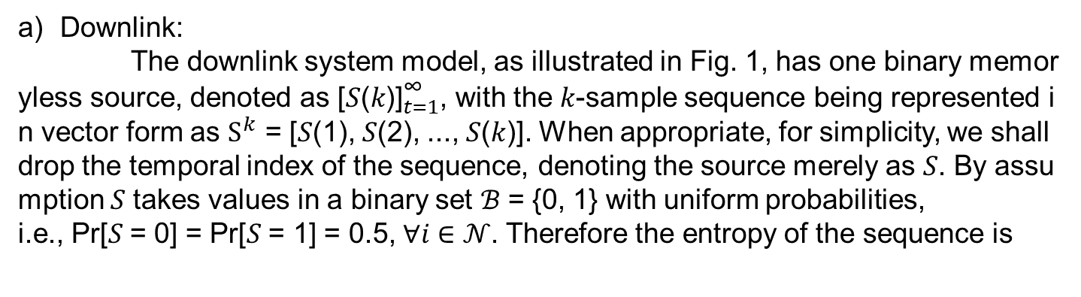
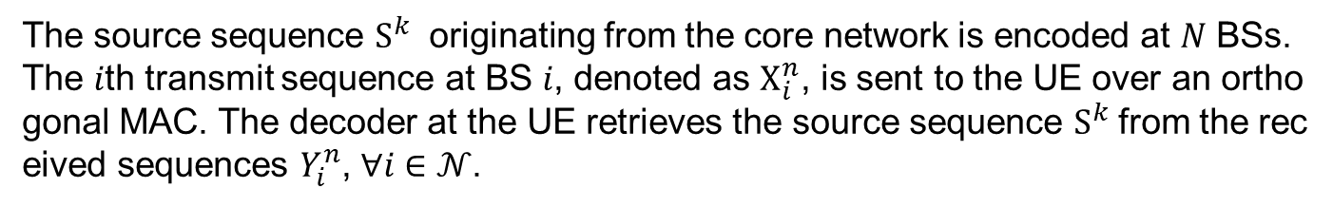
Multi-Connectivity System Model
Downlink:
The downlink system model, as illustrated in Fig. 1, has one binary memoryless source, denoted as ${\text{[}\text{S}\text{(}\text{k}\text{)]}}_{t=1}^{\text{∞}}$, with the 𝑘-sample sequence being represented in vector form as $S^{k}$ = [𝑆(1), 𝑆(2), ..., 𝑆(𝑘)]. When appropriate, for simplicity, we shall drop the temporal index of the sequence, denoting the source merely as 𝑆. By assumption 𝑆 takes values in a binary set ℬ = {0, 1} with uniform probabilities,
i.e., Pr[𝑆 = 0] = Pr[𝑆 = 1] = 0.5, ∀𝑖 ∈ 𝒩. Therefore the entropy of the sequence is
The source sequence $S^{k}$ originating from the core network is encoded at 𝑁 BSs. The 𝑖th transmit sequence at BS 𝑖, denoted as $X_{i}^{n}$, is sent to the UE over an orthogonal MAC. The decoder at the UE retrieves the source sequence $S^{k}$from the received sequences $Y_{i}^{n}$, ∀𝑖 ∈ 𝒩.
Notes:
Downlink 部分是binary memoryless source(無記憶源)是指當前符號獨立於所有先前輸出符號的源， k個sample sequence 可以表示成下面的那個vector，每個S 帶0 或1的機率是一樣的，因此是機率是0.5，
那它的熵值 可以用表示成這樣，source sequence S𝑘 是從core network 發出並在base stations中encode的， 這邊將encode後的訊息表示成Xn I 然後UE 收到的訊息表示成 Yn I 並在這邊做decode ，將訊號還原。

Slide 7
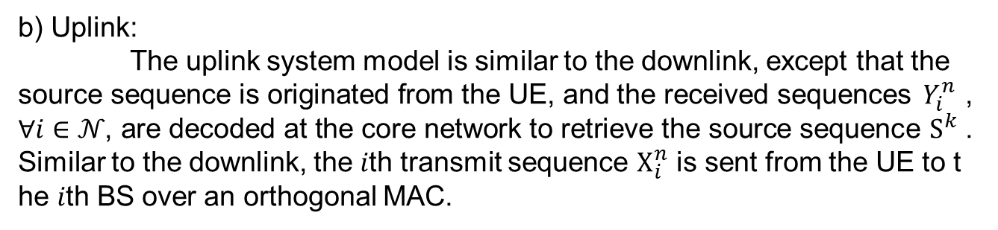
b) Uplink:
The uplink system model is similar to the downlink, except that the source sequence is originated from the UE, and the received sequences $Y_{i}^{n}$ , ∀𝑖 ∈ 𝒩, are decoded at the core network to retrieve the source sequence $S^{k}$. Similar to the downlink, the 𝑖th transmit sequence $X_{i}^{n}$ is sent from the UE to the 𝑖th BS over an orthogonal MAC.
Notes:
Uplink部分與downlink相似 ，但是在core network 來去decode的

Slide 8
Link Model
Instead of sending multiple sequences at different time instances, i.e., coding in time, we use multiple frequency channels to transmit the information. Thus, the information can, in the best case, be delivered in a single time slot, which helps satisfying the URLLC requirements.
According to [13], the small-scale fading of two signals is approximately uncorrelated if their frequencies are at least separated by the coherence bandwidth, which is confirmed, for instance, by measurement results in [14].
Notes:
為了要coding in time，這邊使用多個frequency channel 來傳送訊息，因此在最佳情況下，訊息可以在單個time slot中傳遞，這樣有助於滿足URLLC的需求
根據研究，如果兩個信號的頻率至少被一定的帶寬分開，則兩個信號的小規模衰落(small-scale fading)幾乎不相關。於是在這篇它假設每個frequency resources至少有分開一定的帶寬，所以保證通道是orthogonal 並且衰弱是獨立的。

Slide 9

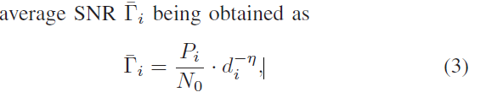
Furthermore, to cope with the low latency constraint in URLLC, we consider relatively short encoded sequences. As a result, the length of an encoded sequence is less than or equal to the length of a fading block of the block Rayleigh fading. Moreover, the signals are transmitted from or to different BSs, which leads to individual average SNR values.
PDF:
Notes:
此外，為了滿足URLLC的低延遲要求，這邊作者考慮使用較短的encoded sequences(編碼序列) 讓這個encoded sequence小於等於block Rayleigh fading 的fading block長度 (fading block 可以想像是在衰弱過程中恆定的部分)
那我們可以假設剛剛的sequence 傳輸過程中經歷block Rayleigh fading 以及additive white Gaussian 後接受到的SNR的機率分布函數可以表示成這樣
𝑃𝑖 is the transmit power per channel
d 是Base station 與UE的位置，
𝜂(壓他) 是 path loss exponent

Slide 10
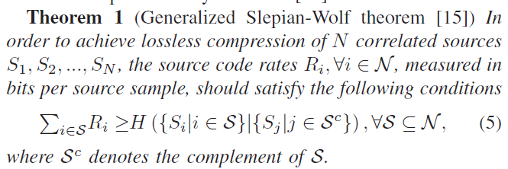
Slepian-Wolf Theorem
Notes:
R: source code rates
意思是當無失真壓縮來自不同source的相關訊息時各個訊息的熵值總和會大於聯合訊息的熵值。 並且合併最小code rate就是聯合訊息的熵值。
根據剛剛有提到的每個symbol互相獨立 其熵值為1 , 因此我們可以將他化簡為 下面形式，代表每個Link的code rate都會大於等於1

Slide 11

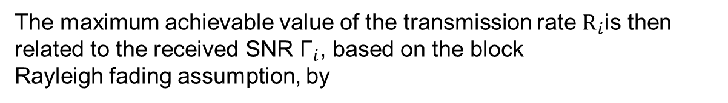
Mapping: SNR to Rate
The maximum achievable value of the transmission rate $R_{i}$is then
related to the received SNR ${\text{Γ}}_{i}$, based on the block
Rayleigh fading assumption, by
Notes:
Ri = transmission rate
𝐶𝑖(Γ𝑖). = capacity
𝜙(fai) = log2(1 + Γ𝑖).
𝑅𝑖,c = the spectral efficiency (measured in source samples per channel input symbol)

Slide 12
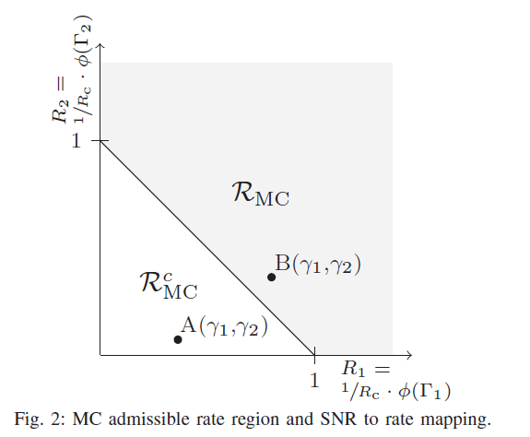
Notes:
MC需要SNR大於一個threshold ，因此當一組訊息進來時，他根據他通道狀況，會有機率落在合法的SNR內以及非法的SNR內。
假設N= 2 並收到2-tuple (𝛾1, 𝛾2).
ℛMC = MC admissible rate region
𝑅1 + 𝑅2 =1

Slide 13
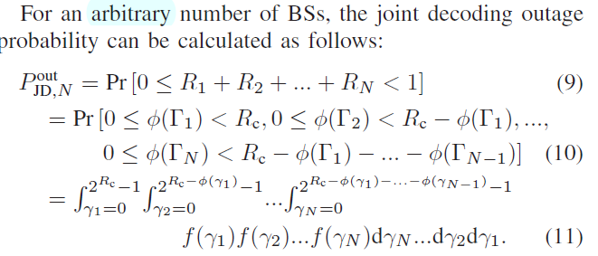
OUTAGE PROBABILITY
Joint Decoding
An outage event occurs whenever the transmission rate 𝑁-tuple 𝑅1, ...,𝑅𝑁 falls outside the MC admissible rate region ℛMC.
Notes:
Outage 發生在transmission rate 落在可接受的rate region外的情況，若是在可接受的rate region外joint decoder就無法完好的重現原本的訊息，
剛剛有講到根據Slepian-Wolf Theorem，一個熵值 也就是他的code rate會大於1 也就是這邊總和小於1的就代表outage

Slide 14

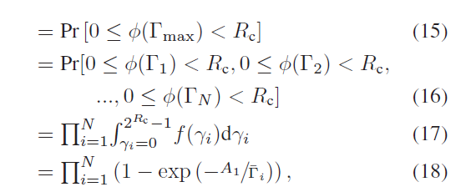
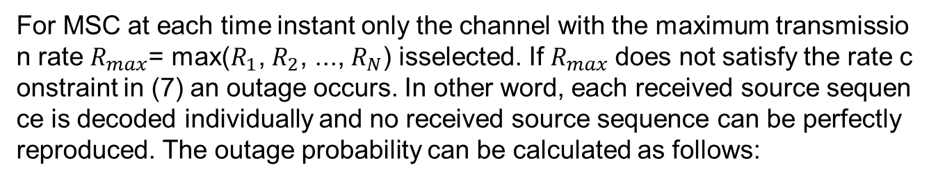
OUTAGE PROBABILITY
Maximum Selection Combining (MSC)
For MSC at each time instant only the channel with the maximum transmission rate $R_{max}$= max($R_{1}$, $R_{2}$, ..., $R_{N}$) isselected. If $R_{max}$does not satisfy the rate constraint in (7) an outage occurs. In other word, each received source sequence is decoded individually and no received source sequence can be perfectly reproduced. The outage probability can be calculated as follows:
Notes:
只選擇所有channel中最大的transmission rate，若最大的Rmax 一樣不滿足rate限制，就會發生outage

Slide 15
OUTAGE PROBABILITY
Maximal-ratio combining (MRC)
In telecommunications, maximum-ratio combining (MRC) is a method of diversity combining in which:
The signals from each channel are added together,
The gain of each channel is made proportional to the rms signal level and inversely proportional to the mean square noise level in that channel.
Different proportionality constants are used for each channel.
Notes:
將所有訊號疊加再進行decode根據 source-channel separation theorem

Slide 16
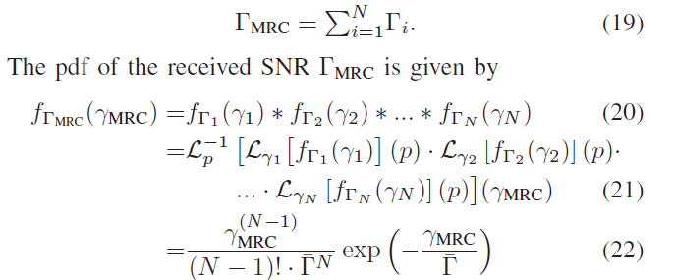
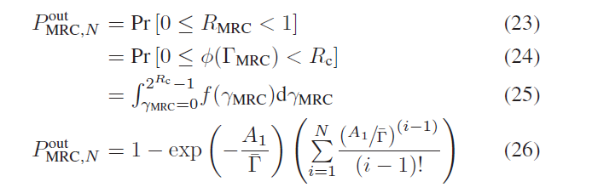
Notes:
total SNR
會長成22行那樣
然後再把22行的東西帶到25行
就可以得到outage probability

Slide 17
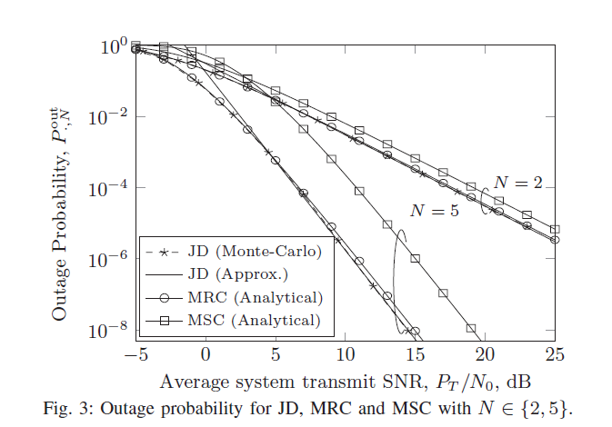
NUMERICAL RESULTS
Notes:
𝜎𝑖(𝑃out∗ )required average system transmit SNR
這邊可以看到當SNR固定為15時，不管base stations數量是2還是5，利用joint decoding 的方式所發生outage的機率比較小

Slide 18
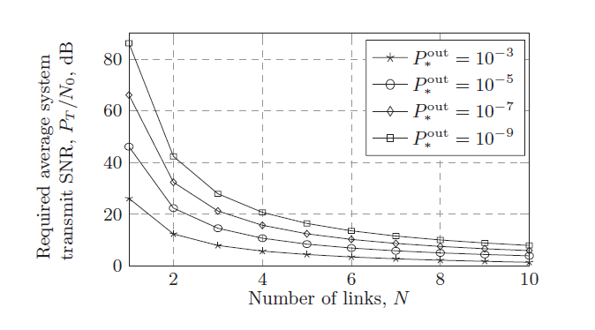
Notes:
然後這個是表示出當不同的base stations數以及不同的outage probability下，所需求的SNR關西圖
可以看到當outage probability固定時links數越多 ，所需要的SNR都會變小

Slide 19

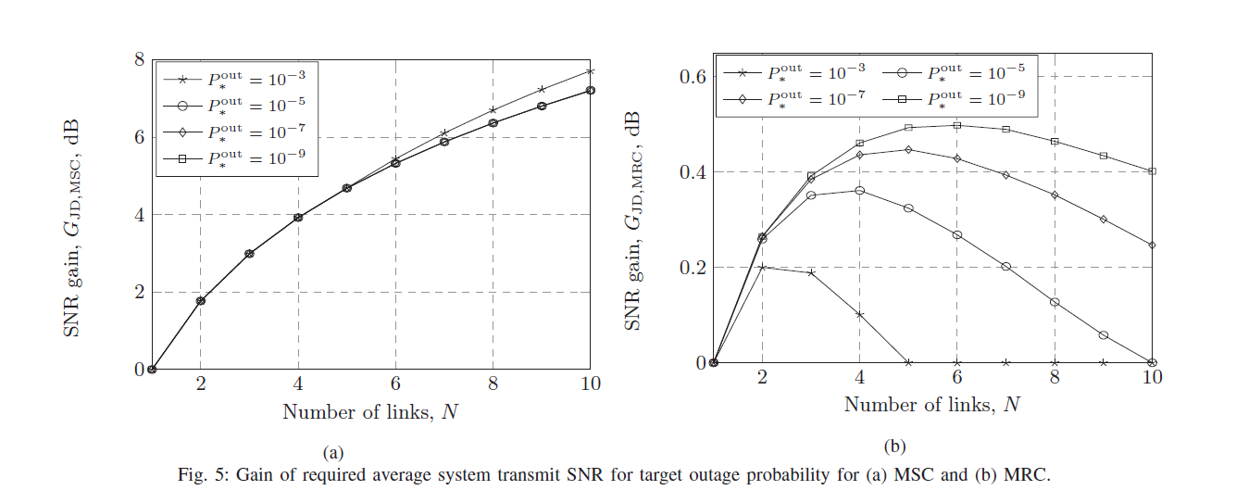
SNR gain
Notes:
Joint decoder 與 其他兩個 MSC MRC 他們的required SNR 比值
可以看到 MRC 再不同的outage probability下會有不同
link數的限制

Slide 20
Conclusion
In this work we have derived and evaluated the outage probability for different combining algorithms, namely, joint decoding, maximum selection combining, and maximum ratio combining in the context of multi-connectivity. The outage analysis has been based on the Slepian-Wolf theorem and the source-channel separation theorem. For all three combining algorithms, we have established a remarkably simple, yet accurate analytical framework to describe the outage probability depending on the number of links, the modulation scheme, the code rate, and the received SNR. We have used the analytical framework to compare the performance and thereby have evaluated the reduction of the required SNR when using joint decoding in comparison to maximum selection combining and maximum ratio combining while achieving the same outage probability.
Notes:
在這項工作中，我們推導並評估了在多連接情況下不同組合算法（即JD，MSC和MRC）的中斷概率。 。 對於所有這三種組合算法，我們已經建立了一個非常簡單但準確的分析框架來描述中斷概率，具體取決於鏈路數量，modulation scheme，編碼率和接收到的SNR。 我們使用了分析框架來比較性能，從而評估了使用JD，MSC和MRC同時達到相同中斷概率相比所需SNR。

Slide 21
Thank you

